Slide 1
Chapter 1
Software & Software Engineering

Slide 2
What is Software?
Software is: (1) instructions (computer programs) that when executed provide desired features, function, and performance; (2) data structures that enable the programs to adequately manipulate information and (3) documentation that describes the operation and use of the programs.

Slide 3
What is Software?
Software is developed or engineered, it is not manufactured in the classical sense.
Software doesn't "wear out."
Although the industry is moving toward component-based construction, most software continues to be custom-built.

Slide 4

Wear vs. Deterioration
“Ideas are the building blocks of ideas” Jason Zebehazy

Slide 5
Software Applications
system software: Compiler, editor, file manager
application software: Standalone program for business applications
engineering/scientific software: CAD
embedded software: reside within the product
product-line software: inventory control products
WebApps (Web applications): e-commerce
AI software: robotics, expert systems,
“ There is no computer that has common sense” Marvin Minsky

Slide 6

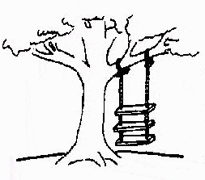
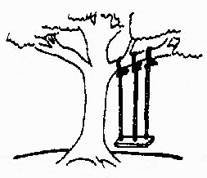

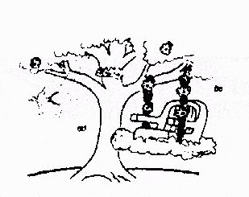
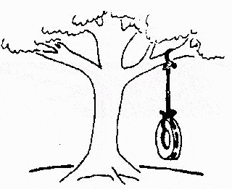
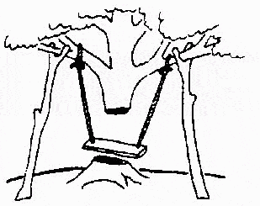
Status of Software Engineering
This is how the problem is solved now
The requirements specification was defined like this
The developers understood it in that way
This is how the problem was solved before.
This is how the program is described by marketing department
This, in fact, is what the customer wanted …
That is the program after debugging

Slide 7


Some Software failures
Y2K problem:
It was simply the ignorance about the adequacy or otherwise of using only last two digits of the year.
The 4 digit date format, like 1964, was shortened to 2 digit format, like 64.

Slide 8
Software—New Categories
Open world computing—distributed computing
Ubiquitous computing—wireless networks
Netsourcing—the Web as a computing engine
Open source—”free” source code open to the computing community (a blessing, but also a potential curse!)
Also … (see Chapter 31)
  Data mining
  Grid computing
  Cognitive machines
  Software for nanotechnologies

Slide 9
Legacy Software
Why must it change?
  software must be adapted to meet the needs of new computing environments or technology.
  software must be enhanced to implement new business requirements.
  software must be extended to make it interoperable with other more modern systems or databases.
  software must be re-architected to make it viable within a network environment.

Slide 10
Characteristics of WebApps - I
Network intensiveness. A WebApp resides on a network and must serve the needs of a diverse community of clients.
Concurrency. A large number of users may access the WebApp at one time.
Unpredictable load. The number of users of the WebApp may vary by orders of magnitude from day to day.
Performance. If a WebApp user must wait too long (for access, for server-side processing, for client-side formatting and display), he or she may decide to go elsewhere.
Availability. Although expectation of 100 percent availability is unreasonable, users of popular WebApps often demand access on a “24/7/365” basis.

Slide 11
Characteristics of WebApps - II
Data driven. The primary function of many WebApps is to use hypermedia to present text, graphics, audio, and video content to the end-user.
Content sensitive. The quality and aesthetic nature of content remains an important determinant of the quality of a WebApp.
Continuous evolution. Unlike conventional application software that evolves over a series of planned, chronologically-spaced releases, Web applications evolve continuously.
Immediacy. Although immediacy—the compelling need to get software to market quickly—is a characteristic of many application domains, WebApps often exhibit a time to market that can be a matter of a few days or weeks.
Security. Because WebApps are available via network access, it is difficult, if not impossible, to limit the population of end-users who may access the application.
Aesthetics. An undeniable part of the appeal of a WebApp is its look and feel.

Slide 12
Software Engineering
Some realities:
  a concerted effort should be made to understand the problem before a software solution is developed
  design becomes a pivotal activity
  software should exhibit high quality
  software should be maintainable
The seminal definition:
  [Software engineering is] the establishment and use of sound engineering principles in order to obtain economically software that is reliable and works efficiently on real machines.

Slide 13
Software Engineering
The IEEE definition:
  Software Engineering: (1) The application of a Systematic, Disciplined, Quantifiable approach to the Development, Operation, and Maintenance of software; that is, the application of engineering to software. (2) The study of approaches as in (1).

Slide 14
A Layered Technology
tools
methods
process model
a “quality” focus
Software Engineering

Slide 15
Software Process
A process is a collection of activities, actions and tasks that are performed when some work product is to be created.
An activity strives to achieve a broad objective (e.g. Communication with stakeholders)
An action (e.g. Architectural design) encompasses a set of tasks that produce a major work product (e.g. An architectural design model)

Slide 16
A Process Framework
Process framework
  Framework activities
    work tasks
    work products
    milestones & deliverables
    QA checkpoints
  Umbrella Activities

Slide 17
Framework Activities
Communication
Planning
Modeling
  Analysis of requirements
  Design
Construction
  Code generation
  Testing
Deployment

Slide 18
Umbrella Activities
Software project management
Formal technical reviews
Software quality assurance
Software configuration management
Work product preparation and production
Reusability management
Measurement
Risk management

Slide 19
Software Engineering
SE is not a rigid production, rather it should be agile and adaptable therefore, a process adopted for one project might be significant different than a process adopted for another project.

Slide 20
Adapting a Process Model
  the overall flow of activities, actions, and tasks and the interdependencies among them
  the degree to which actions and tasks are defined within each framework activity
  the degree to which work products are identified and required
  the manner which quality assurance activities are applied
  the manner in which project tracking and control activities are applied
  the overall degree of detail and rigor with which the process is described
  the degree to which the customer and other stakeholders are involved with the project
  the level of autonomy given to the software team
  the degree to which team organization and roles are prescribed

Slide 21
The Essence of SE Practice
Polya suggests:
    1. Understand the problem (communication and analysis).
    2. Plan a solution (modeling and software design).
    3. Carry out the plan (code generation).
    4. Examine the result for accuracy (testing and quality assurance).

Slide 22
Understand the Problem
Who has a stake in the solution to the problem? That is, who are the stakeholders?
What are the unknowns? What data, functions, and features are required to properly solve the problem?
Can the problem be compartmentalized? Is it possible to represent smaller problems that may be easier to understand?
Can the problem be represented graphically? Can an analysis model be created?

Slide 23
Plan the Solution
Have you seen similar problems before? Are there patterns that are recognizable in a potential solution? Is there existing software that implements the data, functions, and features that are required?
Has a similar problem been solved? If so, are elements of the solution reusable?
Can subproblems be defined? If so, are solutions readily apparent for the subproblems?
Can you represent a solution in a manner that leads to effective implementation? Can a design model be created?

Slide 24
Carry Out the Plan
Does the solution conform to the plan? Is source code traceable to the design model?
Is each component part of the solution provably correct? Has the design and code been reviewed, or better, have correctness proofs been applied to algorithm?

Slide 25
Examine the Result
Is it possible to test each component part of the solution? Has a reasonable testing strategy been implemented?
Does the solution produce results that conform to the data, functions, and features that are required? Has the software been validated against all stakeholder requirements?

Slide 26
David Hooker’s General Principles
1: The Reason It All Exists
2: KISS (Keep It Simple, Stupid!)
3: Maintain the Vision
4: What You Produce, Others Will Consume
5: Be Open to the Future
6: Plan Ahead for Reuse
7: Think!

Slide 27
Software Myths
Misleading attitudes that have caused serious problems for managers and practitioners.
Affect managers, customers (and other non-technical stakeholders) and practitioners
Are believable because they often have elements of truth,
but …
Invariably lead to bad decisions,
therefore …
Insist on reality as you navigate your way through software engineering

Slide 28
How It all Starts
SafeHome:
  Every software project is precipitated by some business need—
    the need to correct a defect in an existing application;
    the need to the need to adapt a ‘legacy system’ to a changing business environment;
    the need to extend the functions and features of an existing application, or
    the need to create a new product, service, or system.

